Slide 1
Ethernet Packet Capture Using Wireshark
Data Communication assignment #1-1

Slide 2
Assignment #1-1
Purpose of assignment
Understand how packets are actually generated and transmitted from the end host to the end host. (Under Ethernet environment)
Submission
ICMP Packet Capture using ping program
ICMP packet analysis
- Result screenshot & report

Slide 3
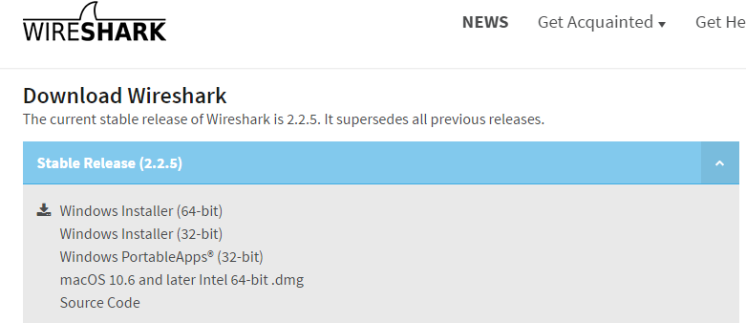
Wireshark – installation
Wireshark is a free and open source packet analyzer. It is used for network troubleshooting, analysis, software and communications protocol development, and education.
Install : https://www.wireshark.org/download.html
No further explanation for installation is necessary….^^
Please install the one that suits your OS

Slide 4
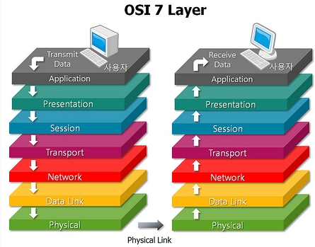
Wireshark - where does Wireshark captures incoming packets?
Basically the capturing framework is placed between “the NIC driver” and “higher layer protocols” in the kernel (e.g. TCP/IP).

Slide 5
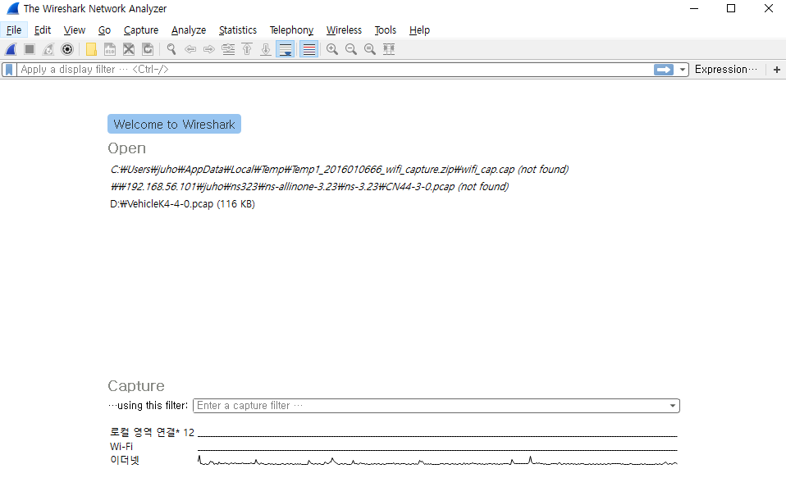
Wireshark – execution example
The first time you run Wireshark, you can see the following screen. (관리자 권한으로 실행하세요)
Select the interface you want to capture packets

Slide 6
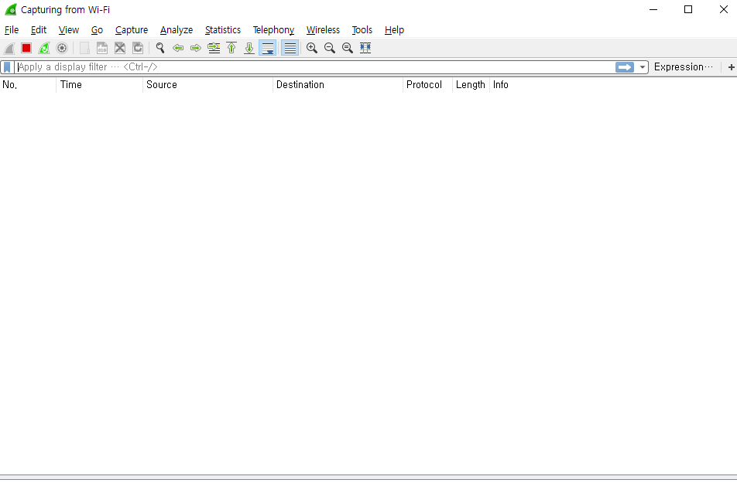
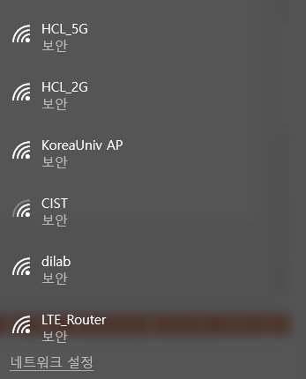
Wireshark – execution example
In the example, I select the wi-fi interface which are not currently connected

Slide 7
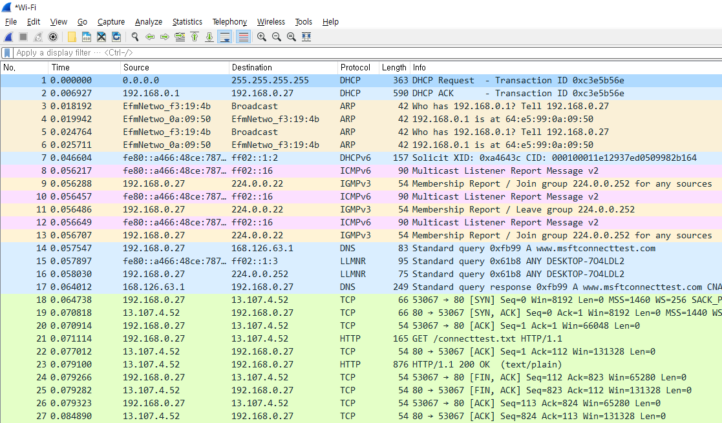
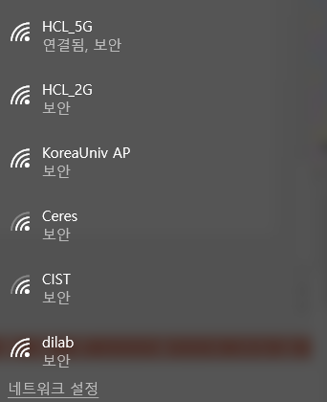
Wireshark – execution example
After the wi-fi connection is finished, you can see that following packet capture results

Slide 8
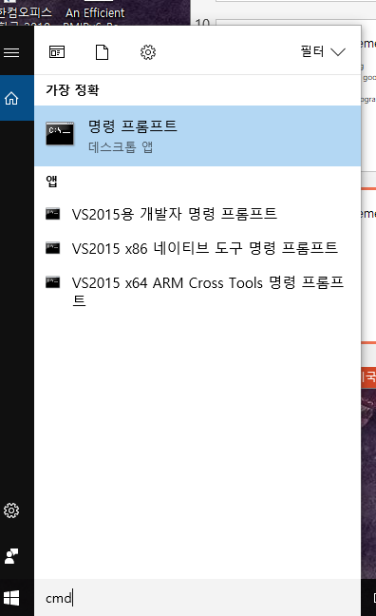
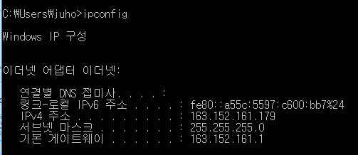
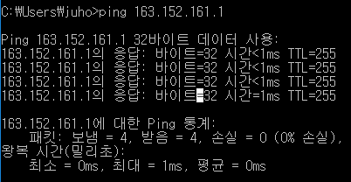
Assignment #1-1 requirements
1) Ping (ICMP Packet Capture (without ICMPv6))
- terminal execution : execute cmd
- find default GateWay IP address using ipconfig command
- Ping command to send ping packet to default G/W

Slide 9
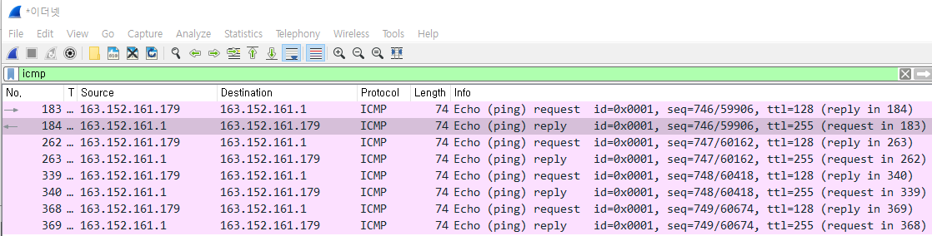
Assignment #1-1 requirements
1) Ping (ICMP Packet Capture)
- wireshark filter : icmp

Slide 10
Assignment #1-1 requirements (5)
1) Ping (ICMP Packet Capture)
1-1) sends the ping packet to the default G/W
1-2) capture the ICMP packets
1-3) Write your own description of what each field in the packet means (ethernet header)

Slide 11
Assignment #1-1 requirements (5)
Ethernet 환경 (유선)에서 ping을 보낸 뒤의 response 받는 것까지 2개의 패킷에 대해
1) 패킷 캡쳐 화면과 Ethernet (802.3) Header 분석

